Slide 1
Music Store Analysis

Slide 2
Easy

Slide 3
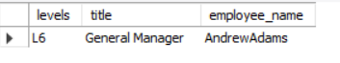
01
Who is the senior-most employee based on job title
Select levels, title, concat(first_name,
last_name) as employee_name
from employee
order by levels desc
limit 1;

Slide 4
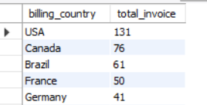
02
Which countries have the most invoices
select billing_country, count(invoice_id) as total_invoice
from invoice
group by billing_country
order by total_invoice desc;

Slide 5
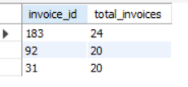
03
What are the top 3 values of total invoices
select invoice_id, round(total) as total_invoices
from invoice
order by total desc
limit 3;

Slide 6

04
Which city has the best customers?
Write a query that returns one city that has the highest sum of
invoice totals.
Return both the city name & sum of all invoice totals.
select billing_city as city_name, round(sum(total)) as invoice_total
from invoice
group by city_name
order by invoice_total desc
limit 1;

Slide 7
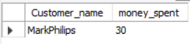
05
Who is the best customer?
The customer who has spent the most money will be declared the best customer.
Write a query that returns the person who has spent the most money.
select concat(c.first_name,
c.last_name) as Customer_name, round(sum(total)) as money_spent
from customer as c
join invoice as i on i.customer_id= c.customer_id
group by Customer_name
order by money_spent
limit 1;

Slide 8
Moderate

Slide 9
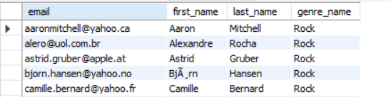
01
Write a query to return the email, first name, last name, & genre of all rock music listeners.
Return your list ordered alphabetically by email starting with A.
select distinct(c.email), c.first_name, c.last_name
from customer c
join invoice i on c.customer_id=i.customer_id
join invoice_line il on i.invoice_id=il.invoice_id
join track t on il.track_id=t.track_id
join genre g on t.genre_id=g.genre_idwhere g.name= "Rock“
order by c.email;

Slide 10
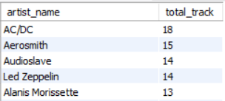
02
Lets invite the artists who have written most rock music in our dataset.
Write a query that returns artist name and total track count of the top 10 rock bands.
select ar.name as artist_name, count(track_id) as total_trackfrom track t
join album2 a on t.album_id=a.album_id
join artist ar on a.artist_id=ar.artist_idwhere genre_id= 1
group by artist_name
order by total_track desc
limit 10;

Slide 11
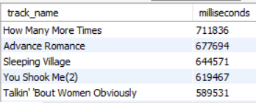
03
Return all the track names that have a song length longer than the average song length.
Return the name and Milliseconds for each track.
Order by the song length with the longest songs listed first.
select name as track_name, milliseconds
from track
where milliseconds >
(select avg(milliseconds)
as avg
from track)
order by milliseconds desc;

Slide 12
Advance

Slide 13
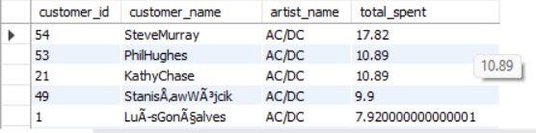
01
select c.customer_id,
concat(c.first_name,c.last_name)
as customer_name,
ar.name as artist_name,
sum(il.unit_price*il.quantity)
as total_spentfrom customer c
join invoice i on
c.customer_id=i.customer_id
join invoice_line il on
i.invoice_id=il.invoice_id
join track t on
il.track_id=t.track_id
join album2 a on
t.album_id=a.album_id
join artist ar on
a.artist_id=ar.artist_id
group by 1,2,3
order by artist_name,
total_spent desc;
Find how much amount spend by each customer on artists
Write a query to return customer name, artist name and total spent.

Slide 14
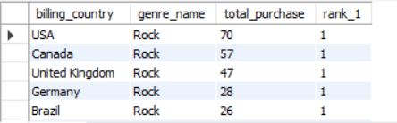
02
with a as(select i.billing_country,g.name as genre_name, count(il.quantity) as total_purchase,
rank()over(partition by i.billing_country
order by count(il.quantity)desc) as rank_1from invoice I
join invoice_line il on i.invoice_id=il.invoice_id
join track t on il.track_id=t.track_id
join genre g on g.genre_id=t.genre_id
group by 1,2
order by 1 asc , 2 desc)
select * from a
where rank_1 =1
order by total_purchase desc ;
We want to find out most popular Music Genre for each country.-- We determine the most popular genre as the genre with the highest amount of purchase.-- Write a query that returns each country along with the top Genre.-- For countries where the maximum number of purchases is shared return all genres

Slide 15
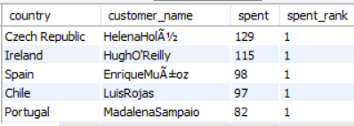
03
with a as (select c.country, concat(c.first_name,c.last_name)
as customer_name, round(sum(i.total)) as spent,
rank()over(partition by c.country order by round(sum(total))) as spent_rank
from customer c
join invoice i on c.customer_id=i.customer_id
group by 1,2
order by c.country asc,
spent desc)
select *
from a
where spent_rank =1
order by spent desc;
Write a query that determines the customer that has spent on music for each country.
Write a query that returns a country along with the top customer and how much they spent.
For countries the top amount is shared, provide all customers who spent this amount

Slide 16
Thank you !

